Slide 1





DevOps CA2
Lim Zhen Yang | 2214506 | DOAA CA2

Slide 2


What is DevOps?
DevOps is a methodology that integrates software development and IT operations through automation, collaboration, and communication to deliver high-quality software faster and more efficiently.
The utilization of code testing and RPA for continuous integration testing, coupled with a deploy hook for continuous deployment, embodies DevOps principles by automating and integrating key processes in the software development lifecycle.

Slide 3


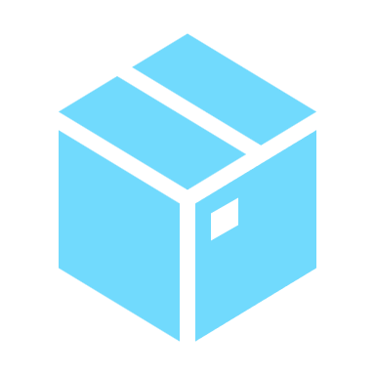

Model Development
Saving models
Testing models
Naming folders with timestamps for version tracking
I did two forms of testing, single input and batch input to ascertain the reliability of the deployed models especially during continuous integration
Containerizing models
Deploying models
With Docker and TensorFlow serving, we can serve both models from the same container efficiently.
To ensure continuous availability of the model, any changes to the main branch is automatically deployed with a deploy hook. This is done with GitLab’s CICD variables for security
Models deployed on: https://ca2-model-server-mfp2.onrender.com

Slide 4


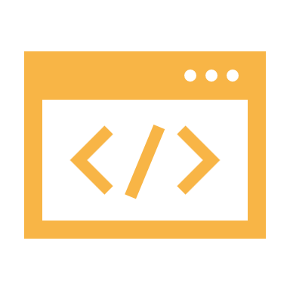
Web Application Development
Developing backend routes
Detailed testing
Use of Postman to check route json returns, status codes, error messages
For each API route, I performed extensive testing such as successful calls and returns, as well as validating expected failures and their returns
Developing frontend
Deploying the application
Vite + React for fast development and deployment. Automatic refreshing of pages during development for efficiency.
Docker to containerize the web application. Built from the base image python 3.8.
Deployed on: https://greens-ai.onrender.com

Slide 5
Development Cycle
Code changes
Push to source control
Run pytest
Error monitoring
Run RPA
Deploy build

Slide 6
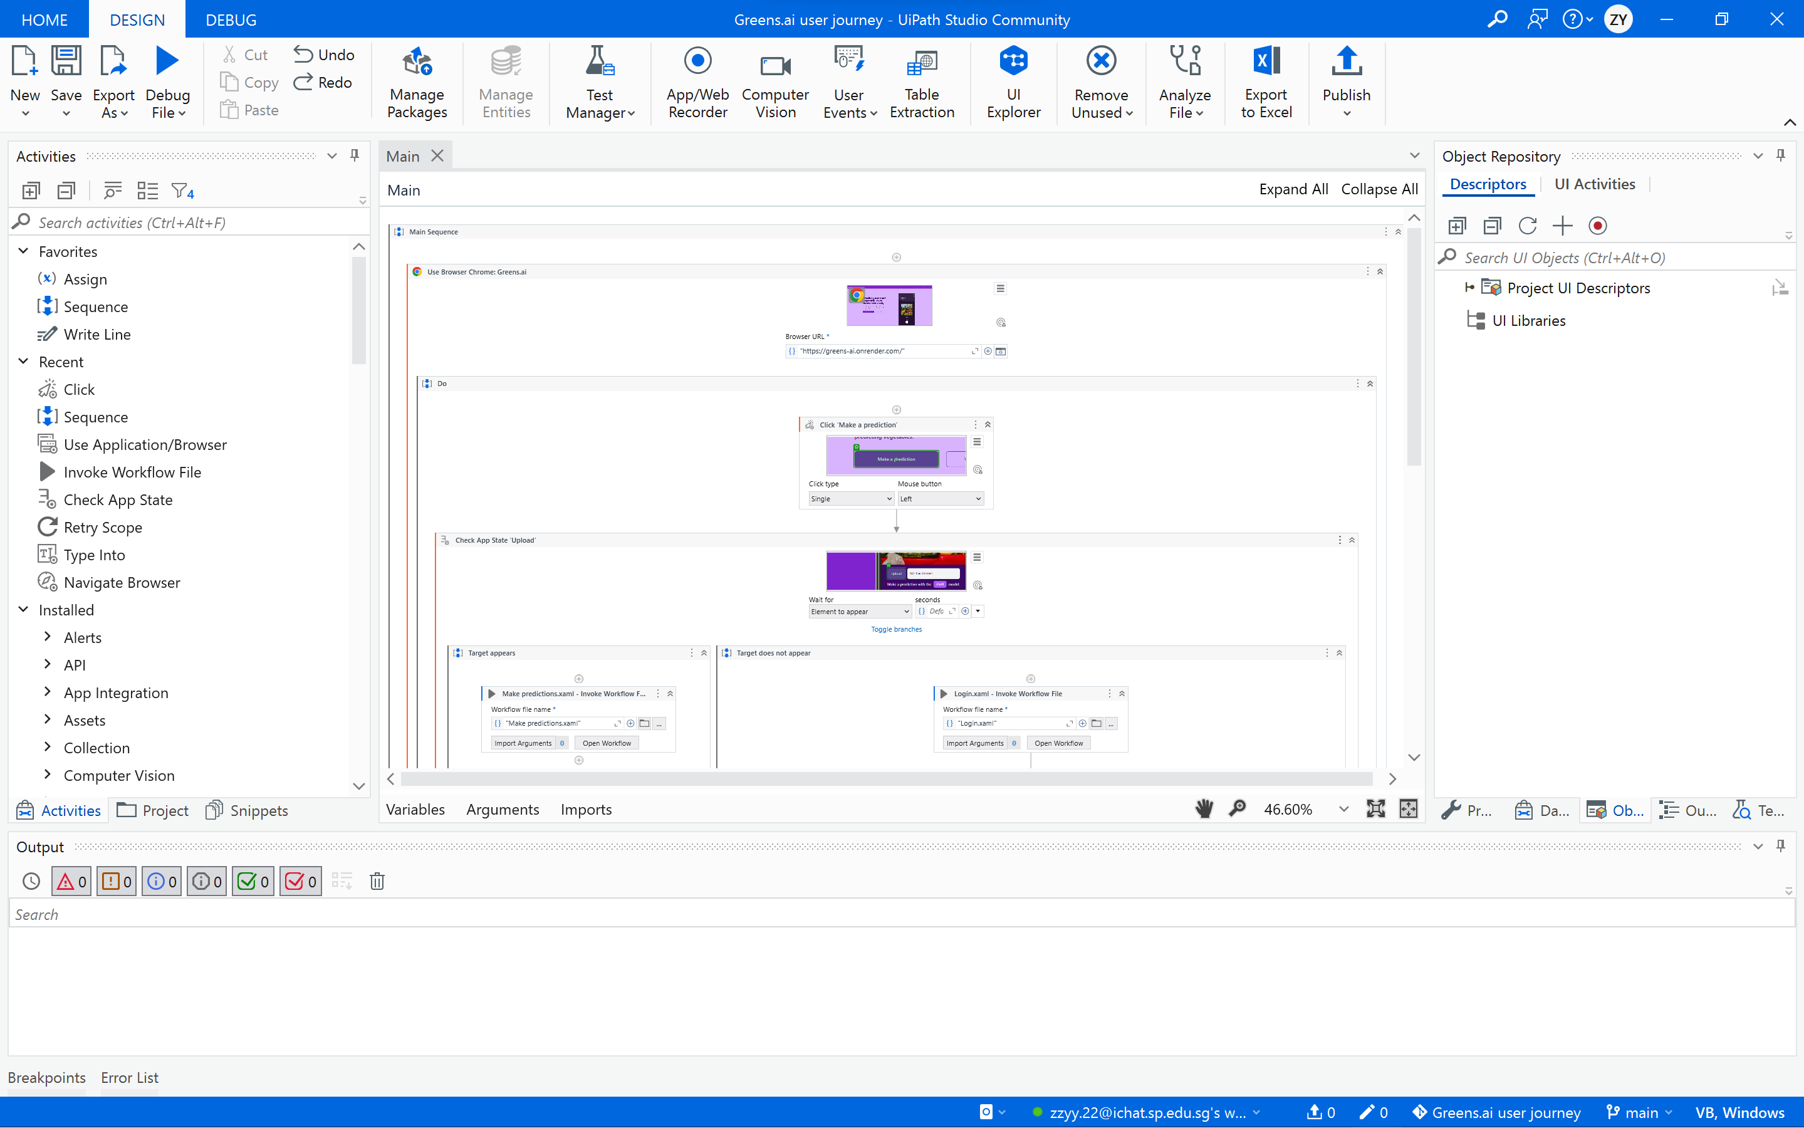
RPA (UiPath)
Simulate an entire user journey on the website
Login
Sign Up
Make predictions
Delete predictions
Searching predictions

Slide 7

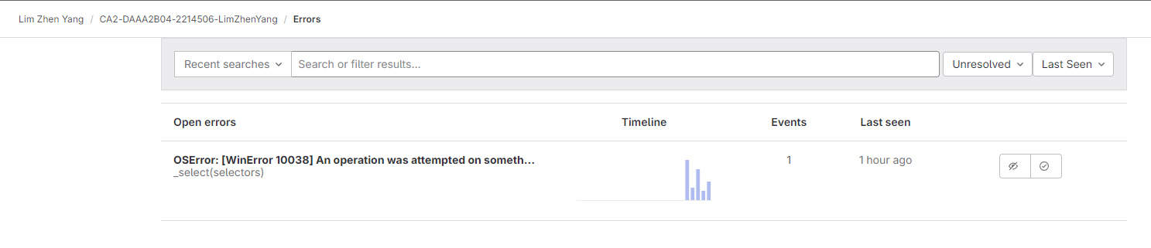
Error Monitoring (Sentry)
To continuously keep track of errors after deployment. By integrating Sentry with GitLab, we can easily see, track, and resolve errors

Slide 8
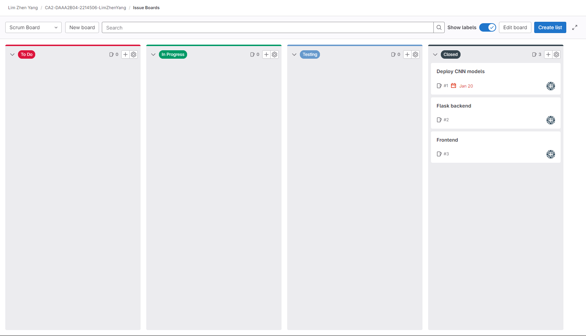
Scrum Board
A Scrum board provides a visual representation of the tasks in a project, facilitating transparency, collaboration, and accountability among team members. It helps teams organize, prioritize, and track their work efficiently, leading to increased productivity and adaptability in Agile development processes.

Slide 9
Branches
Main
I have created branches for each new feature I implemented but the main ones are
Main
Client
Flask-backend
CICD
Protected branch, no code breaking changes should occur here
Client
Frontend development
Flask-backend
Backend development
CICD
Creating the CI/CD pipeline for GitLab to execute

Slide 10
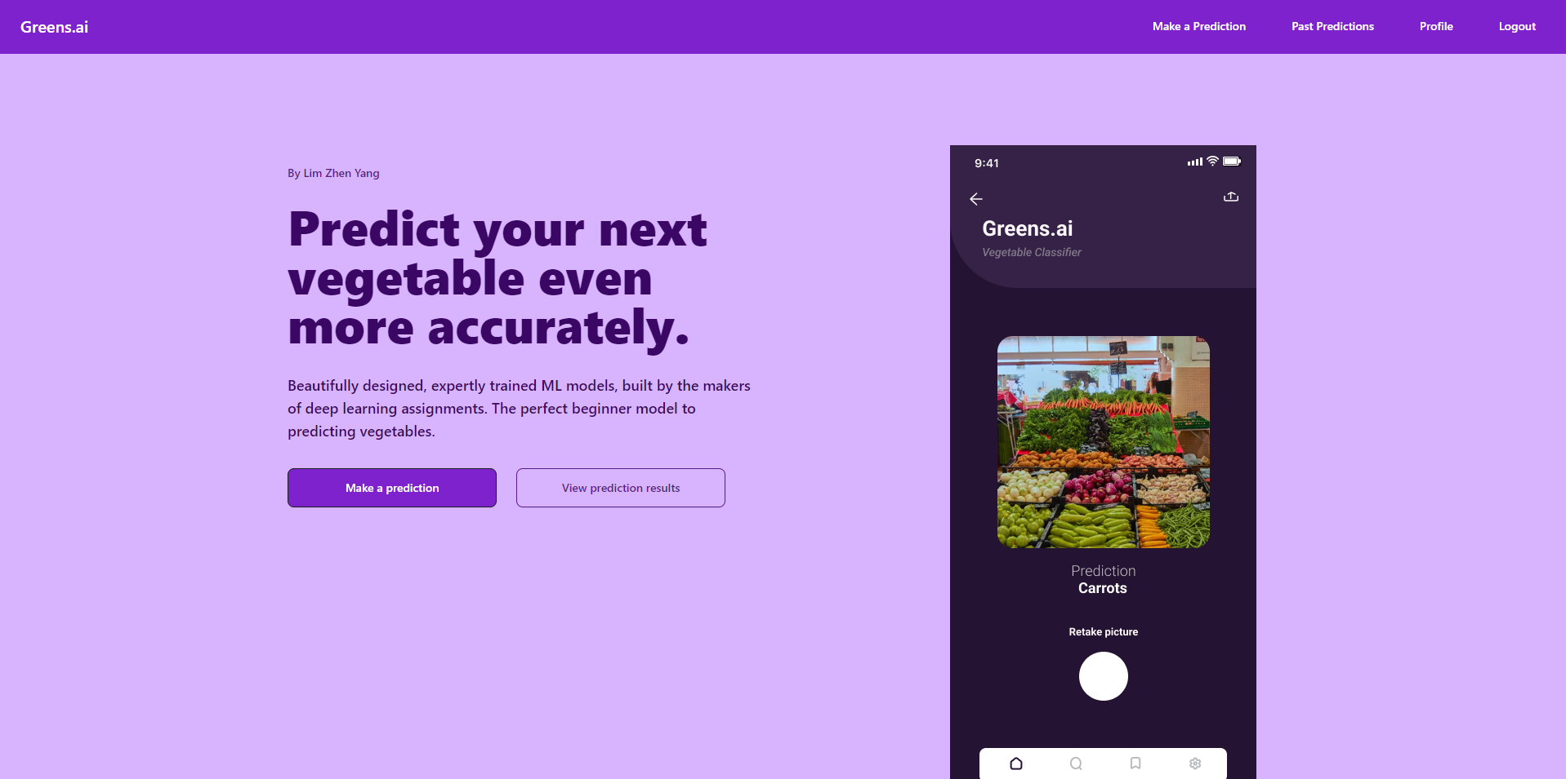
Home Page
Link to prediction page

Slide 11
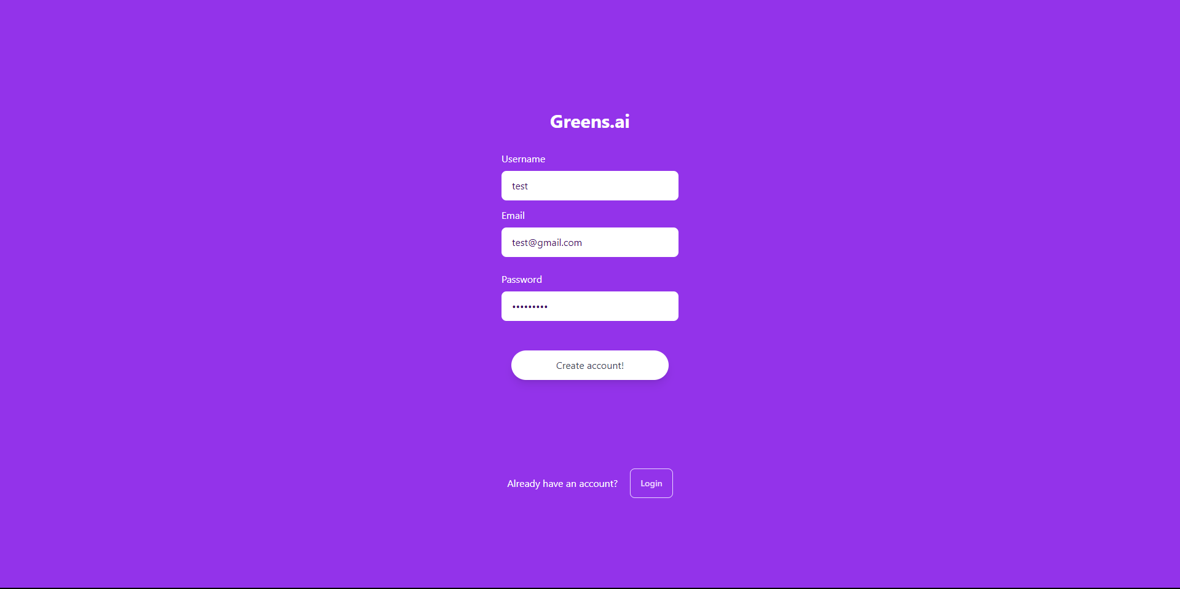
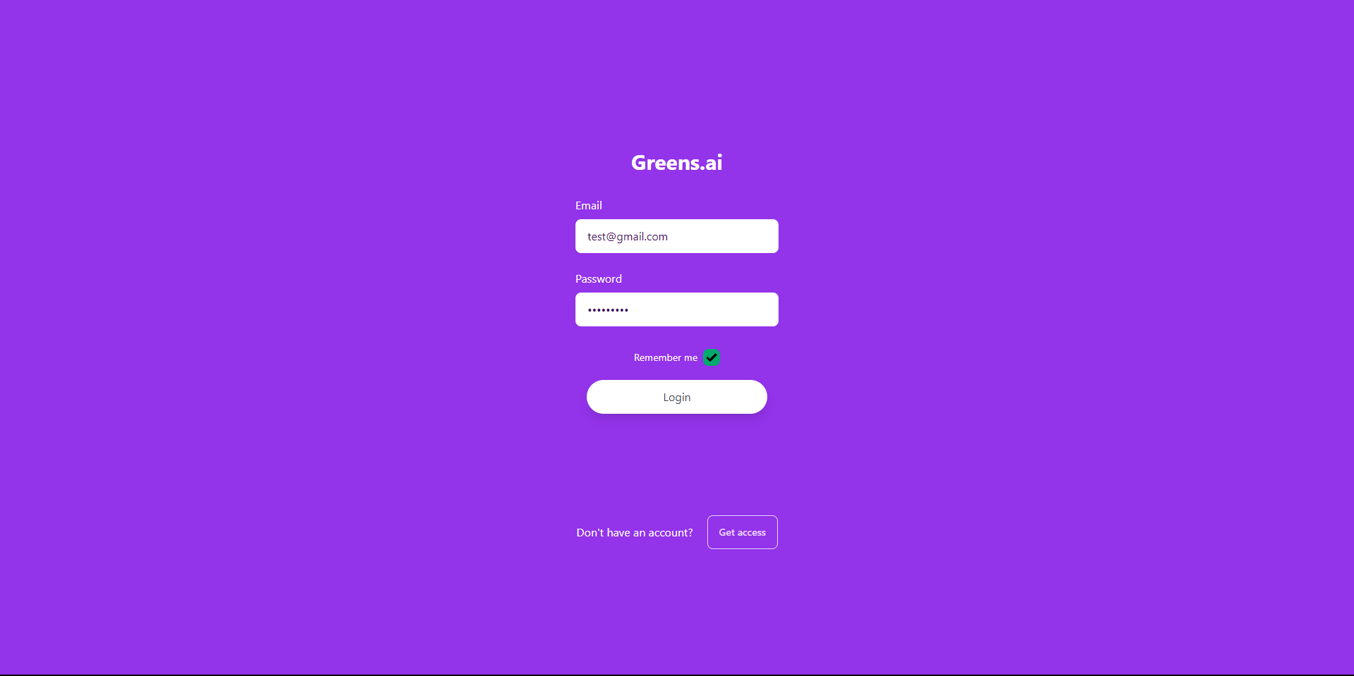
Sign Up and Log In
Sign Up
Log In

Slide 12
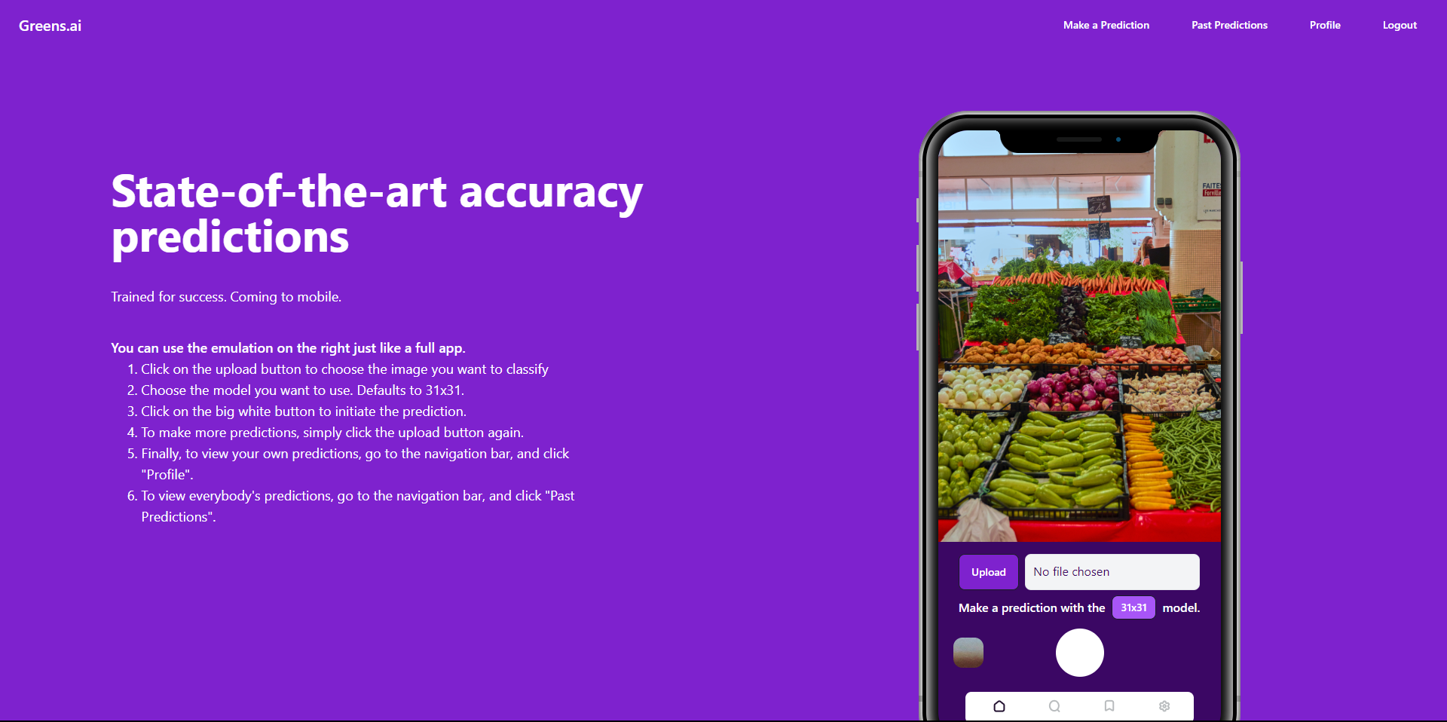
Prediction Page
Create prediction from this phone emulator

Slide 13
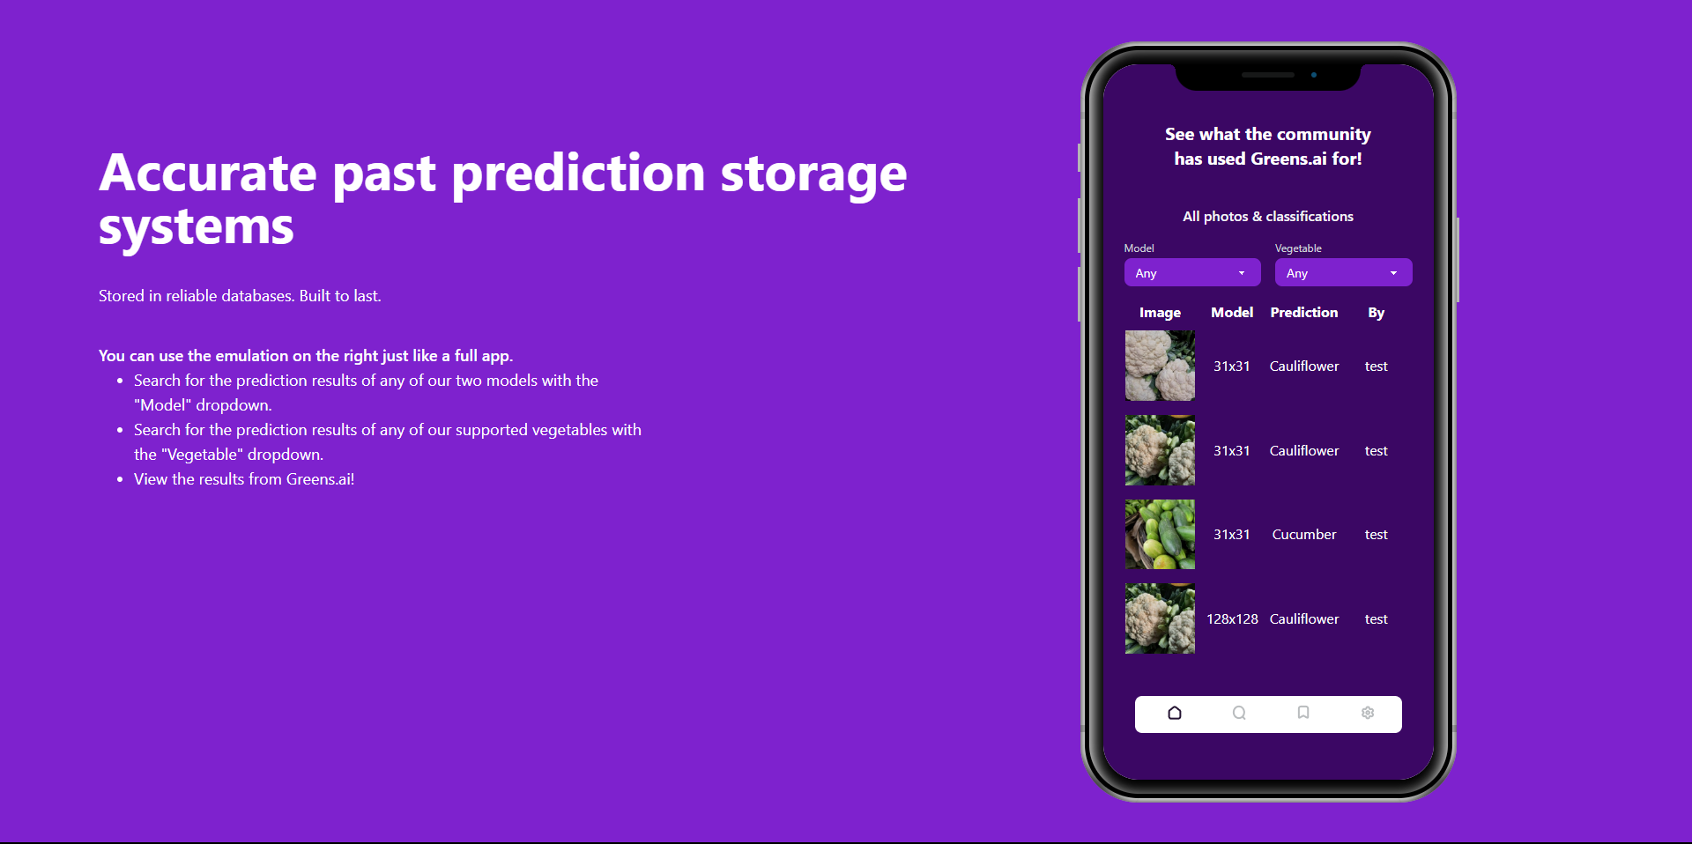
Past predictions page
Prediction history of all users

Slide 14
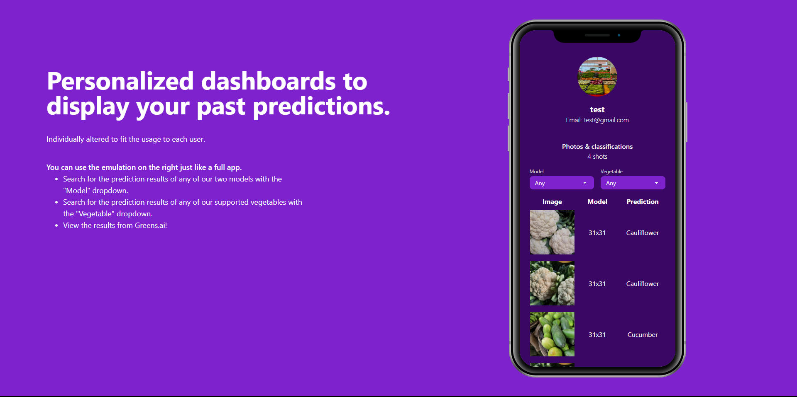
Profile page
Filter and search past predictions
Display past predictions

Slide 15
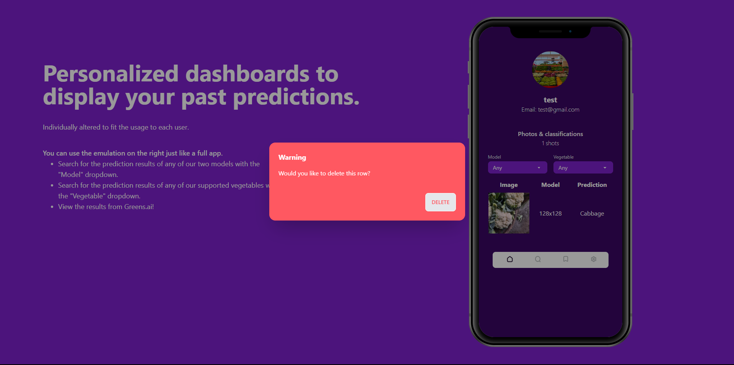
Profile page
Clicking on a row opens this pop up

Slide 16
Next steps
Model Development
WebApp Development
From the continuous collection of more images, we can train our model to improve it.
Any issues such as low model accuracy can be a detected by user feedback.
Errors arising after deployment detected by Sentry can be quickly tracked by development.

Slide 17


Thanks!

